Slide 1





Community Service Project
MENTOR TRAINING - DAY 1

Slide 2

Session 2
90 mins
Introductions
Intro: Community Service Project, Objectives and Expectations

Slide 3
Ice Breaker
SWITCH ON AND OFF YOUR CAMERA IF….

Slide 4
Introductions
My Name is _______________________, the object that represents me is ________________ because __________________
[CHAT BOX]

Slide 5

THINK…….THINK…….
What is community service? [CHAT BOX - Answer in a word or two]
Did you participate in any community service event?[SHOW THUMBS UP EMOJI]
If yes, what is it? [CHAT BOX]
How did it make you feel? [CHAT BOX]

Slide 6

What is Community Service?
Work done by a person or group of people which will benefit others
It is often done in the area you live in
It is mainly performed on volunteer basis
Whom it benefits?
Children
Citizens
People with disabilities
Animals
Environment

Slide 7
Introduction to Community Service Project
OBJECTIVES:
To sensitize the students to the living conditions of the people
To help students to realize the stark realities of the society
To bring about an attitudinal change in the students
To make students aware of their inner strength

Slide 8
To make students socially responsible citizens who are sensitive to the needs of the disadvantaged sections
To help students to initiate developmental activities in the community in coordination with public and government authorities.
To develop a holistic life perspective among the students
Linking the community and college for mutual benefit

Slide 9
Is CSP different than other programs? How? [CHAT BOX]
Students as primary change makers
Catering to professional and personal development shaping them into responsible citizens
Understanding different social systems
Making informed choices about social resources
Positively influences their way of living
Decentralised contextual development

Slide 10
IMPLEMENTATION
Minimum of 180 hour
Each class assigned with 1 mentor teacher
4 credits to CSP within CBCS
Departments could concentrate on their specific areas of concern
Log book - Evaluation - Grading done by concerned mentor
Final evaluation shall reflect on the marks memo
The CSP must be different than that of NCC/NSS/Green Corps/ Red Ribbon Club
Minor Project Report - VIVA

Slide 11


PROCEDURE
Conducting a baseline survey on selected topic
Can choose project topic from a wide range of topics
A specific example, A student of B.Sc (BZC) will first conduct a survey of his/her habitation which could be related to a specific area or in a comprehensive way of socioeconomic conditions, covering all the areas listed above.
or
Could conduct an awareness programme on Health and Hygiene or in Organic Farming or in Fisheries or in advocating prohibition of liquor or about renewable energy, or any other activity in an area as per his/her aptitude and the problems identified in the socioeconomic survey conducted.

Slide 12





Slide 13
OUTCOMES
Enhanced Learning
Career Development
Social Outcomes
Networking - stakeholders
Personal

Slide 14
BENEFITS OF CSP
FACULTY | COLLEGES | COMMUNITY
Quality of student learning | Institutional Commitment | New energy & Enthusiasm
Avenue for research & publication | Student Retention | Trained human resource
Networking opportunities | Community Relations | Out of the box solutions
Sense of commitment

Slide 15
Objectives of the training
To inculcate a sense of community service, social responsibility
To sensitize the master trainers on certain development issues
To build the capacities of master trainers to hand hold the students
To enable the students, identify problem areas, collect basic data and report the findings

Slide 16

See you all at 2pm again :)

Slide 17
Session 3
90 mins
Intro: UN SDG’s and SDG agenda 2030
Alignment of SDG’s and Localisation of SDG’s Overview

Slide 18



Slide 19
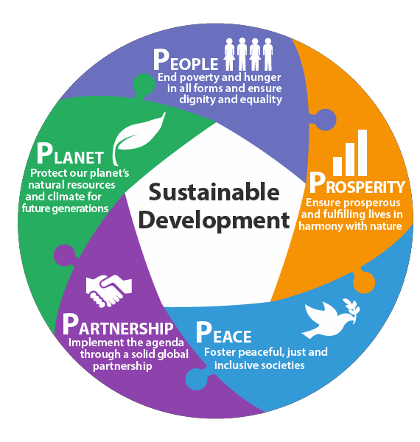
Understanding Sustainable Development Goals
Succeeded the Millennium Development Goals (MDG)
Set of 17 goals, 169 targets
Time Period- 2016-2030
Universal goals, designed to end poverty, protect the planet and ensure peace and prosperity
Addresses 3 dimensions of development
Economic Growth
Social Inclusion
Environmental Protection
Focus on 5Ps

Slide 20






Relevance of SDGs
Realistic, Focus driven action-oriented targets
Time-bound, Universal goals
Scope for greater mobilization of global community
Emphasis on sustainable development to address global challenges
Promote innovation, sharing of expertise and best practices
Capture not just targets but also the process

Slide 21

# 17 Goals of Development

Slide 22
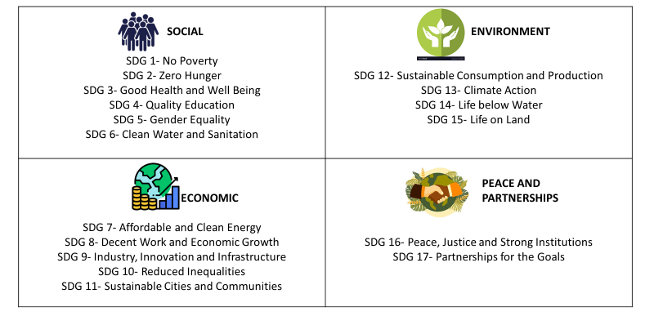
SDGs – Crosscutting & Multidimensional

Slide 23
National Strategy for Achieving SDGs
Mapping of Ministries and Programs
Identification of Indicators
National Strategy for Achieving SDGs
Consultation with Stakeholders
Meticulous implementation of schemes aligned with SDGs
Dovetailing the National Development agenda with SDGs

Slide 24
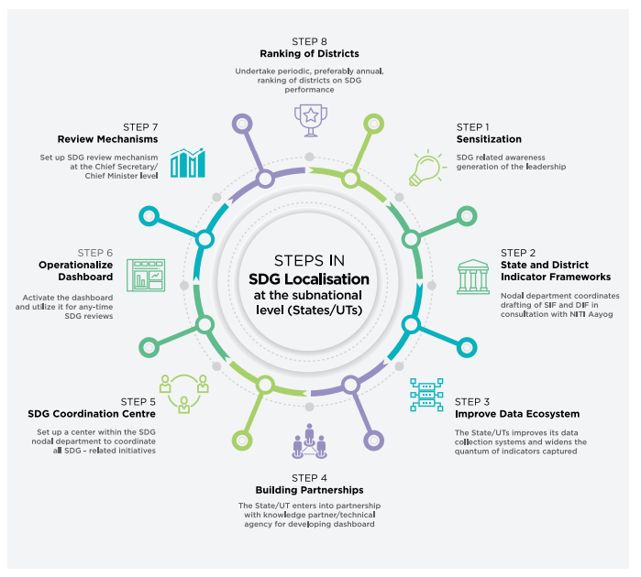
SDG Localization

Slide 25
Localization of SDGs- AP Case Study
All departments and schemes aligned to SDGs- Incorporated as part of Vision 2029 document of the state
Outcome Budgets prepared for all departments- Departments present targets and indicators and key outcomes
District Vision statements and policies developed
SDG monitoring and reporting on 212 indicators through Real-time Outcome Monitoring System.
Comprehensive and Real-time information disaggregated to district level and presented on public domain
High level political forum on Sustainable Development conducted in 2017 and sensitization of all level government officials
Strategies designed for poorly performing blocks and districts

Slide 26
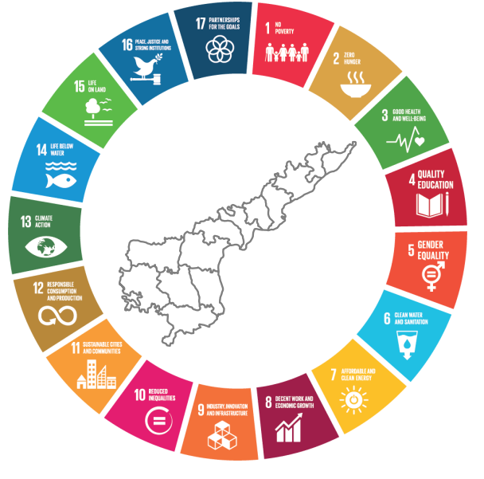
Andhra Pradesh and SDGs
Andhra Pradesh ranks fourth on 2021 SDG India Index by NITI Aayog
“Navaratnalu” – Flagship program to achieve the goals focusing on agriculture, health, education, housing, welfare and other sectors
State Indicator Framework and District Indicator Framework developed

Slide 27
Andhra Pradesh and SDGs
Improved ranking from 4th in 2018 to 3rd in 2021.
Top performer in SDG 16“Peace, Justice and Strong Institutions” and SDG 6 “Clean Water and Sanitation”
Second Best Performer among all states in SDG 3- Good Health and Well Being
Second Best Performer in SDG 8- Decent Work and Economic Growth and SDG 13- Climate Action, SDG 14- Life Below Water
East Godavari, Visakhapatnam and SPSR Nellore are the top performing district

Slide 28
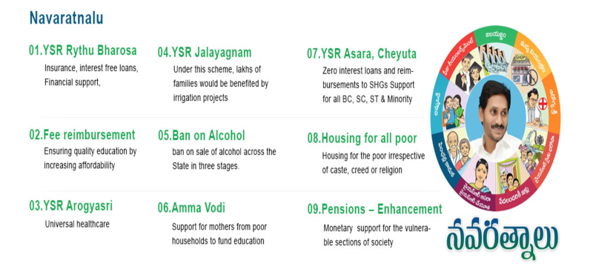

Slide 29
Activity
List 3 Development Themes/Development Goals you think are important
Against each of these development themes/goals, please list out the activities that can be undertaken to achieve these goals in your college/community
Map the relevant SDG to the activities that you have listed

Slide 30
BREAK
15 MINS

Slide 31
Session 4
120 mins
Intro: NFHS Data, Present reflections on the state of AP & it’s Socio Economic Survey
Role of Youth & Mentors in achieving the objectives of Community development program

Slide 32
Have you participated in any government surveys/ any survey before?

Slide 33
Government of India along with NITI Aayog and other ministries publish various reports across different sectors measuring various aspects.
NHFS Survey
Economic Survey
State wide Socio Economic Survey
Census
Good Governance Report
NITI Aayog Innovation Index
NITI Aayog SDG Index
Multidimensional Poverty Index

Slide 34
Why do you think government collects data and publish reports.

Slide 35
What does these surveys and reports tell us about:
Understand the communities and citizens better
Effectiveness of centre and state initiatives /interventions under key economic indicators
Critically analyse the performance of different states in various sectors on key economic and social indicators
Help to identify areas to improve, focus and prioritise to provide better governance
Come up with better policies as per the data

Slide 36
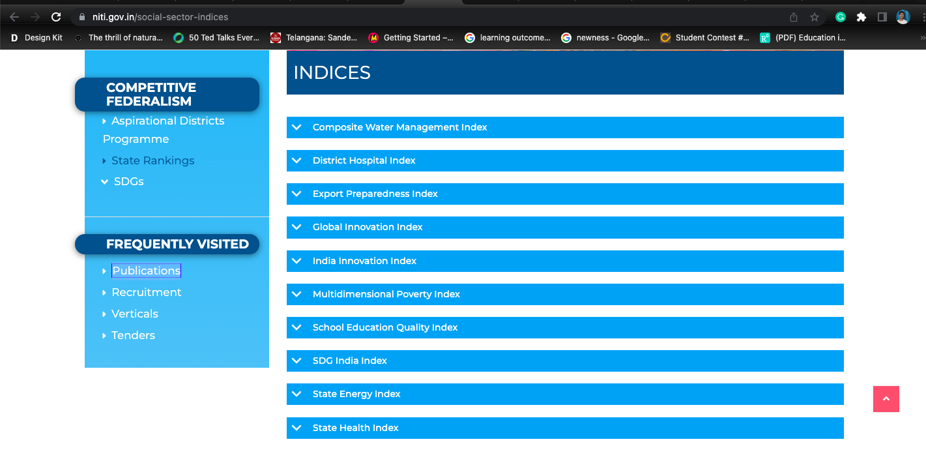

Slide 37
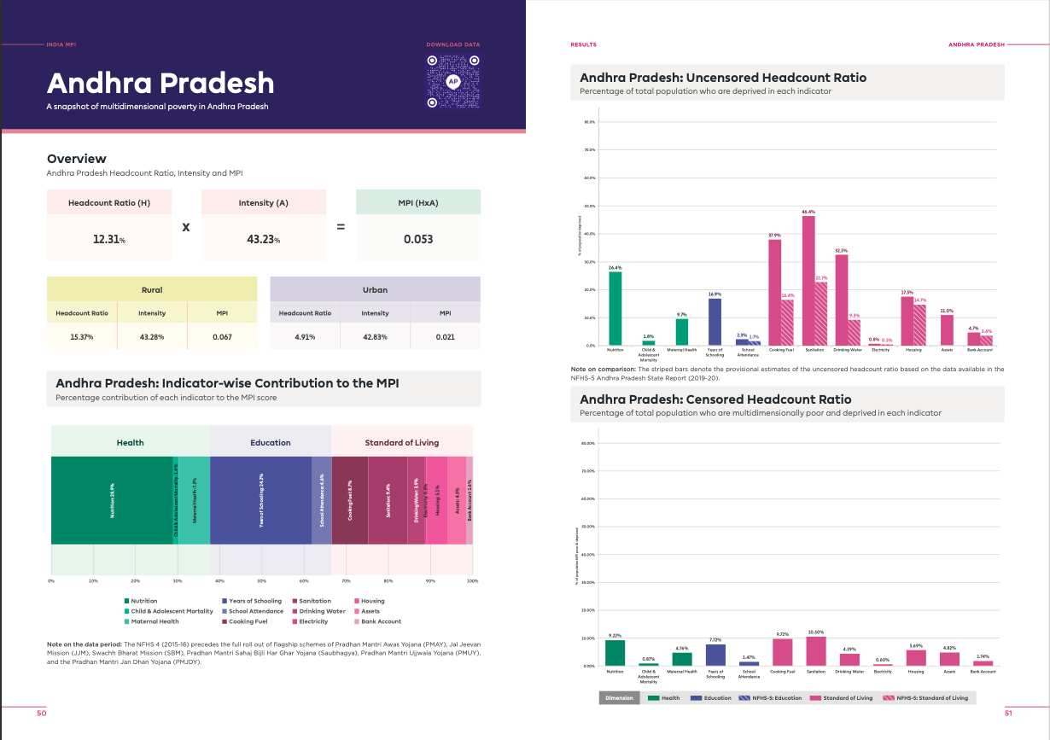

Slide 38
09
Andhra Pradesh stands 9th in India Innovation Index by NITI Aayog
AP scored the highest of 37.06 when it comes to Business Environment, while it got the lowest of 4.04 when it comes to Knowledge Workers
Notes:
BB

Slide 39
20th
Andhra Pradesh stands 20th in Multi-Dimensional Poverty Index
MPI is based on multiple and simultaneous deprivations faced by households across health, education and living standards
12.31 per cent poor population, stands at 20th place in the country in the National Multidimensional Poverty Index (MPI).
26.38% of population are deprived of nutrition
9.66% are deprived of maternal health
11% of population deprived of assets

Slide 40
10
Andhra Pradesh stands 10th (Group A) in Human Resource Development.
Human Resource Development Sector covers the primary and secondary education, skill development and other related areas.
Notes:
Indicators have been identified focussing on learning outcomes like qualityof education and retention rate. In addition, indicators like enrolment ratio, gender parity, skill trainings and placement ratio are also included. A total of seven indicators are identified in this sectorS

Slide 41
7
Andhra Pradesh stands 10th (Group A) in Public Infrastructure and Utilities.
The public infrastructure and utilities sector focus mainly on the governance aspects of the basic services provided by the government such as water supply, sanitation, roads and highways, power and other societal infrastructure.
Notes:
Public Health is one of the priority areas for development. Under this sector, six key indicators are identified looking at the outcomes like Maternal Mortality Ratio (MMR), Infant Mortality Rate (IMR), immunisation achievement, etc. Overall operationalisation and resources availability are also captured through indicator such as availability of doctORS

Slide 42
Niti Aayog report laid 3 recommendations that states can follow to increase performance over different parameters.
Notes:
Inqui - TFG Collaborated Projects

Slide 43

Have to produce more knowledge and data
From analysis we have seen that although the country has performed well in the human capital pillar, however it has not performed well in the knowledge worker pillar. This contrasts with the expectation that the two tend to move simultaneously. This implies that the expenditure on human capital has been unable to create that knowledge base in the country, which could be due to the intricate reasons of bureaucracy, administration, outreach, etc.

Slide 44
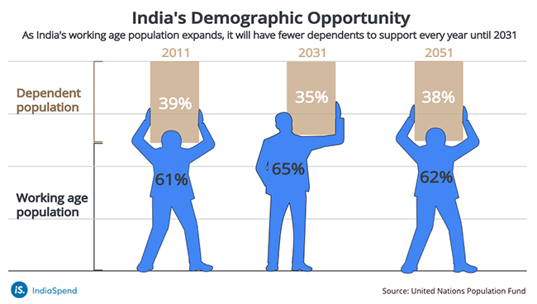
Demographic Dividend
We are yet to take full advantage of our demographic dividend. Given, that about 60% of the population lies in the working age category, there lies a huge scope for more people taking action within the country, whereby the energy and potential of this age group can be channelized.

Slide 45

Skill Gap : What we produce + What industry needs
One needs to sincerely fill the gap between industry demand and what we produce through our education systems. Universities have the potential to become the go-to-place for industries, for any sort of innovation.
Notes:
Develop skills through doing this project

Slide 46


To improve Andhra Pradesh state’s on above Parameters, following 3 things has to be done:
Better understanding of communities
Involving young people in solving problems. Utilizing the advantage of demographic dividend.
Civic participation + Initiatives

Slide 47
In alignment with Nation’s vision and involve young people in solving community problems, government of Andhra Pradesh launched Community Development Program to drive positive change in the communities.
Notes:
Inqui - TFG Collaborated Projects

Slide 48



Objectives
Sensitise students with living conditions of people around them
Help students understand realities of the communities
Bring an attitudinal change in the students and help them
Develop a sense of social responsibility, responsibility, and accountability

Slide 49



Objectives
Make students discover their inner strengths and help them to find innovative solutions to the social problems.
Make students socially responsible citizens who are sensitive to the needs of the disadvantaged sections.
Help students initiate development activities in the community by providing needed support

Slide 50






Pathway to become future innovators and entrepreneurs
Empathy
Innovators
Confidence
Nurturing Problem Solving abilities through CDP
Entrepreneurs
Collaboration
By providing an opportunity for students to solve problems and support their problem solving journey, the Community Development Program acts as a starting point to become innovators and entrepreneurs.

Slide 51

Is Community Development the responsibility of Government alone?

Slide 52
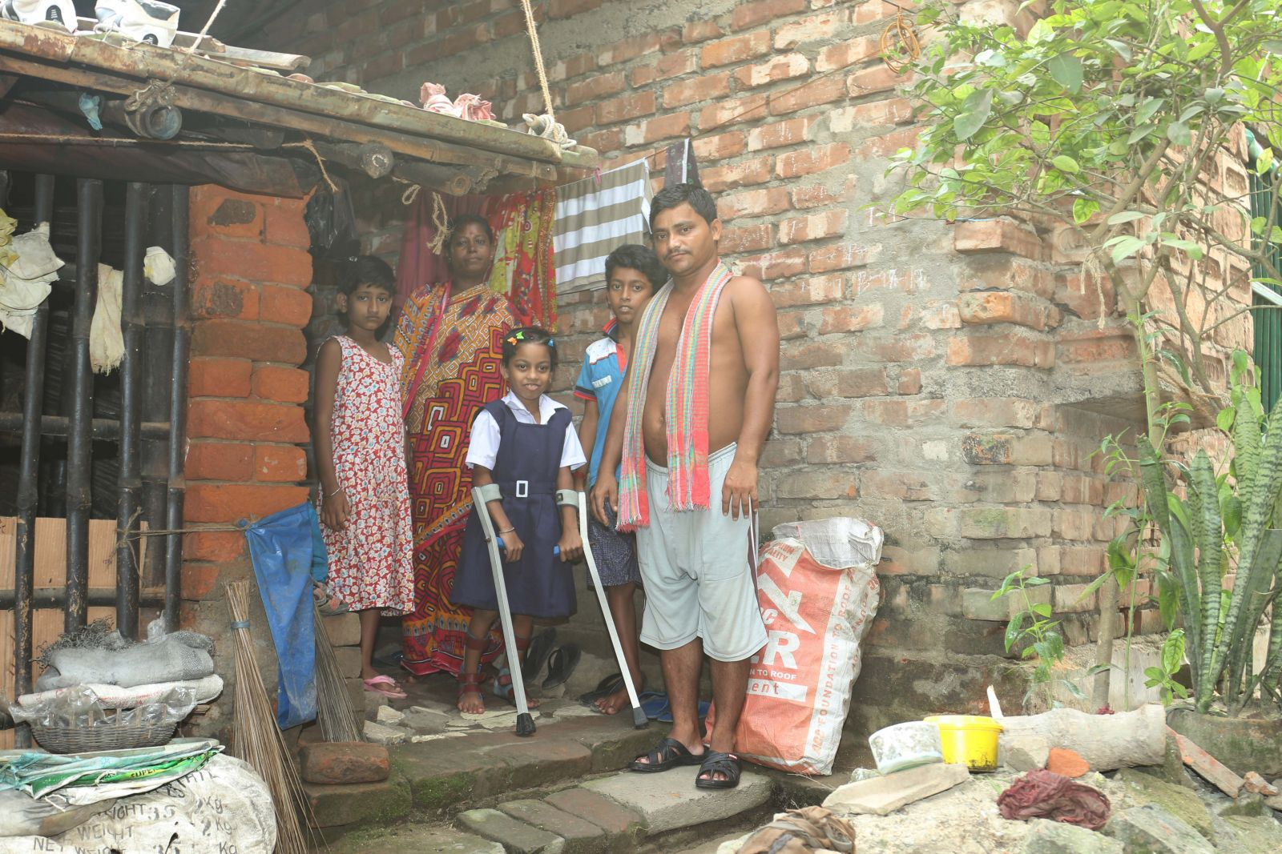
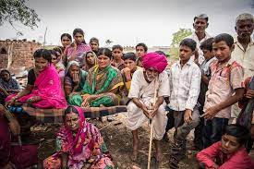
Community development is the participation of people in a mutual learning experience involving themselves and their local resources
(People+Participation= Community Development)

Slide 53

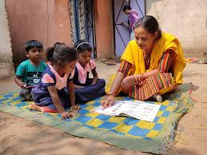
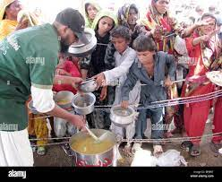
Who are the people?
Socially responsible citizens who work for the benefit of the entire community.

Slide 54
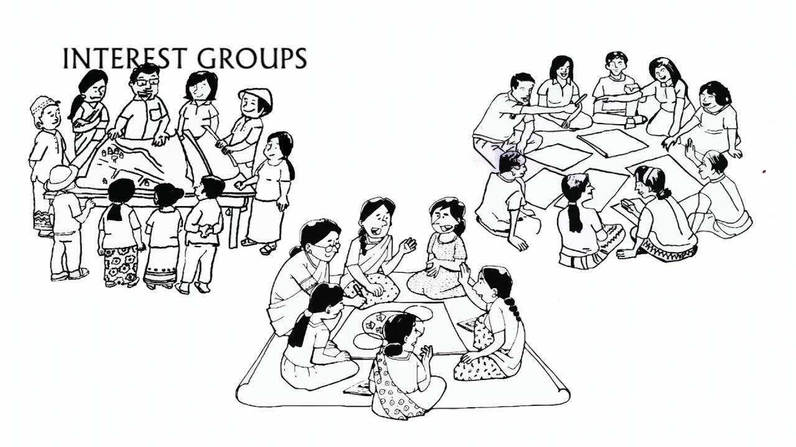
What is Participation?
The involvement of people to understand and solve problems

Slide 55

Why involve Youth?
Access to hard-to-get samples
Less cynical, affinity to technology, and can take more risks
Increased understanding and better interpretation of data
Addressing community needs and challenges

Slide 56
Students can also…
Act as facilitators for govt/non-govt agencies in the college
Associate with other non-govt entities working in that habitat
Rope in district administration for deployment of the program
Organise in-house training and induction Program

Slide 57

Benefits to students
Skill Development
Social Competencies
Self confidence
Identity exploration
Social Capital

Slide 58
Case Study of Terai, Nepal
Political instability- Government and Nepal Maoists
Government failed to fulfil the expectations of the people that led to increase in criminal activities
The Government officials worked from the district headquarters because of security issues
The rural communities therefore did not have access to even basic facilities
To address such conflict imposed vulnerabilities and to empower youth many organizations came forward and funded community development projects in Central and Eastern Terai.

Slide 59
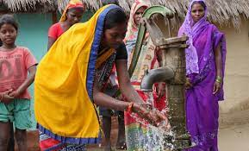
These projects empowered youth to work on small-scaled development projects with other community members.
The Youth worked on projects like school infrastructure, health camps, rural roads, and hand pumps etc.
They even spread awareness on self-reliance and mobilized community funds to development activities.
They have set up Youth Mobilization Committee and strengthened the local Government and worked on bigger issues like Electricity, irrigation, etc.
This competence made the youth members to get invited for council meetings and thus they became important decision makers of the community.

Slide 60

Gaps of Youth Participation in Community Development
Inadequate awareness
Lack of motivation
Lack of professional connections
Improper program planning
Lack of Funds

Slide 61

What is mentoring? Who is a mentor?
Mentorship is the influence, guidance, or direction given by a mentor. A mentor is someone who teaches or gives help and advice to a less experienced and often younger person.

Slide 62

Role of a Mentor in CDP
Teacher
Advisor
Liaison
Role Model
Coach
Confidante

Slide 63

We are Done for Today!! See you Tomorrow :)

